Slide 1
The Parking Assignment Problem
By: Faiz Aladin
Advisor: Christine Chung

Slide 2
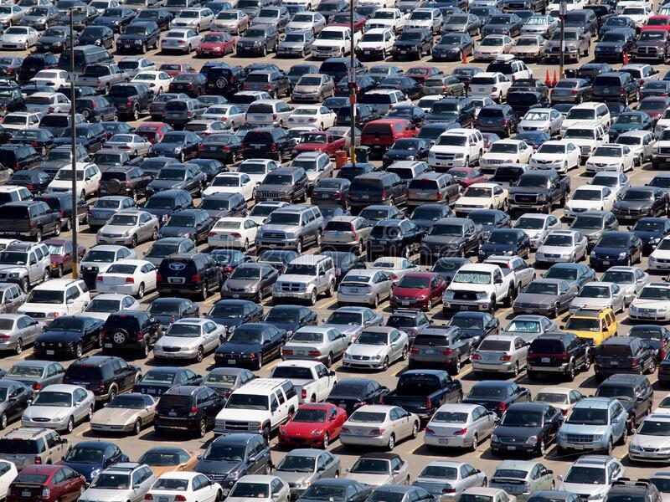
Introduction
Problem
The overflow of cars on college campuses is an issue that affects many students, faculty, and staff.
In particular, Connecticut College has seen an increase in the number of students with cars each year, while the number of available parking spots remains the same.
Notes:
Ticketing unregistered cars

Slide 3
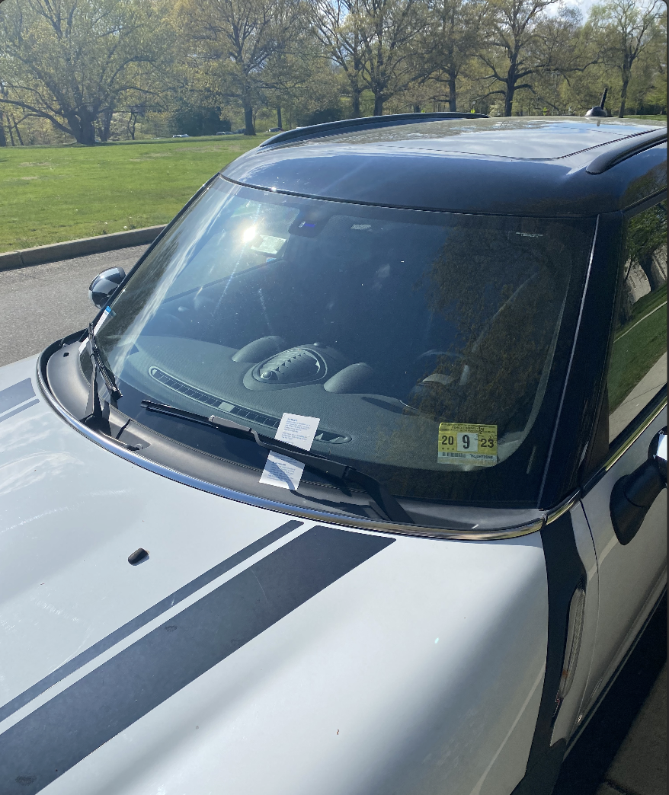
Current Parking Situation
Parking is a free for all (no assigned spots)
Numerous unregistered cars parking on campus
Students parking in illegal spots
Faculty are unable to park in their designated parking spots

Slide 4
How do we solve this?
Assign spots to students. How?
Approach 1: Randomly assign spots to students
Approach 2: Create a parking spot lottery system
Approach 3: Assign spots to students with the goal of minimizing average walking distance for all students
Notes:
Maybe number these as Approaches 1-3

Slide 5
Approach 2: Lottery System
Two greedy algorithms for recommending spots:
Total Walking Distance Algorithm
Returns spot with the minimum sum of walking distance from each class location and dorm to the parking spot
Centroid Algorithm
Finds the center point of a student’s class and dorm locations and returns the parking spot closest to that center point
Notes:
Parking spot recommendation algorithm

Slide 6
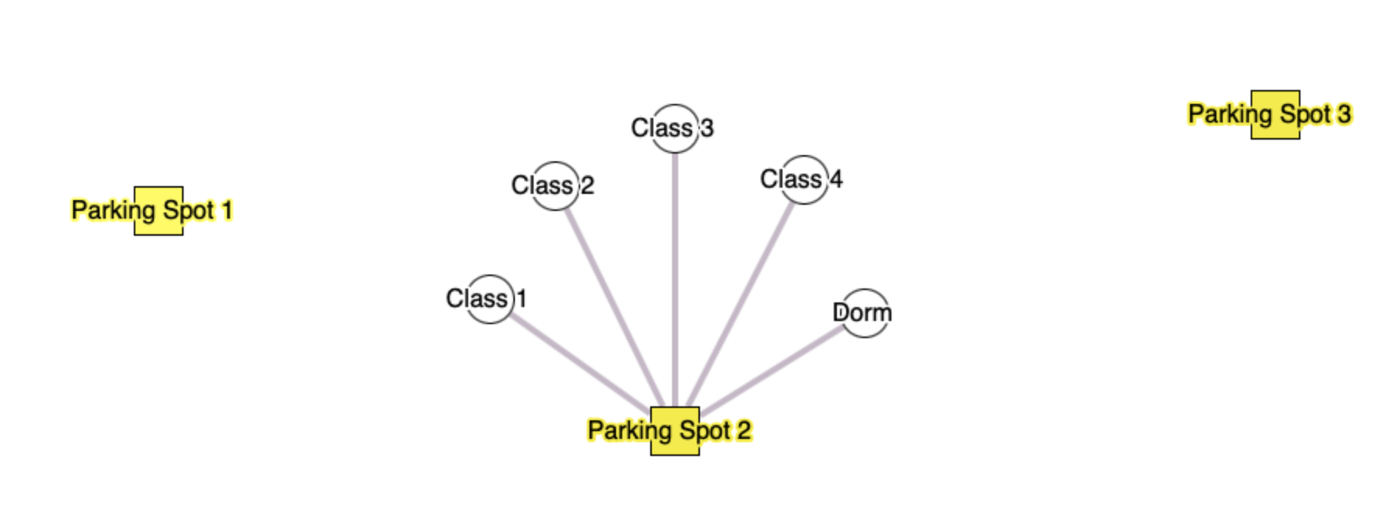
Minimum Distance Rule
Notes:
Draw dotted lines to other spots so signify worse spot.
Make text black instead of yellow.
Change color of parking spots to distinguish them from other points.

Slide 7
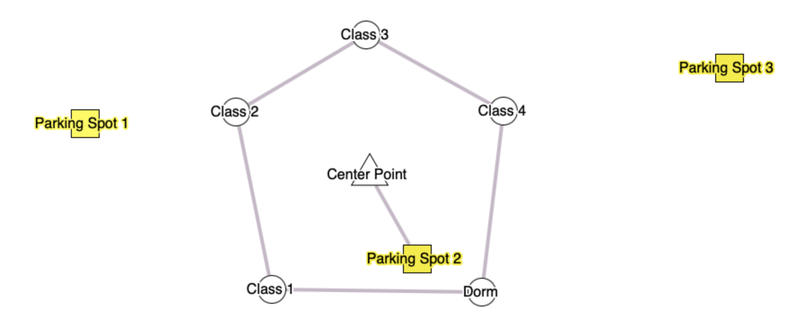
Centroid Algorithm
Notes:
Center Point a different color from Parking Spots which is also a different color from Class locations

Slide 8
Approach 3: Minimizing Average Walking Distance
Hungarian Algorithm
Create matrix with a list of students and a list of total walking distances to each parking spot for each student
Try to assign the minimum walking distance to each student such that the overall walking distance of the entire campus is minimized
Local Search Algorithm
Start with an arbitrary assignment of students to spots
If swapping student i’s spot with student j’s spot improves their average/combined walking distance then swap them
Keep swapping until total walking distance is no longer improved
Notes:
Look for some nice visual way to explain how/why it works a bit in an overarching way without technical details

Slide 9
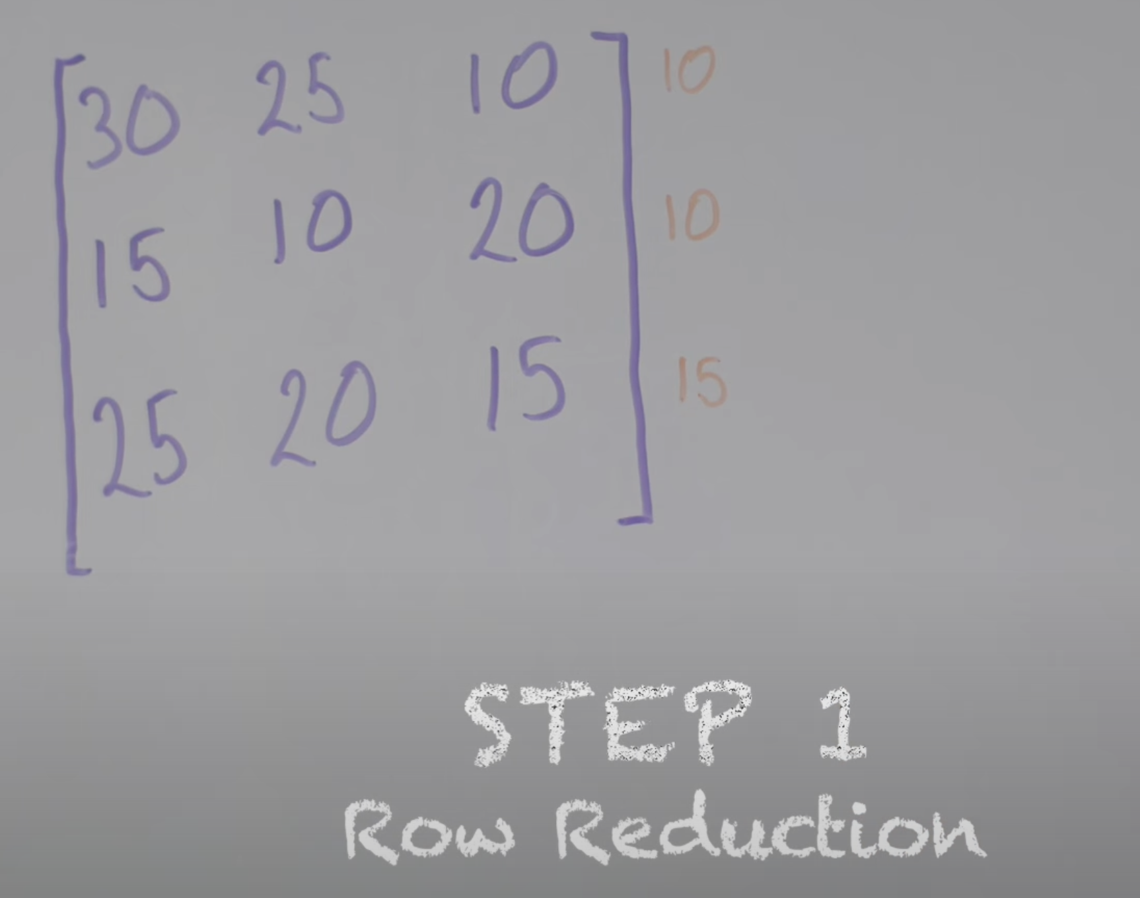
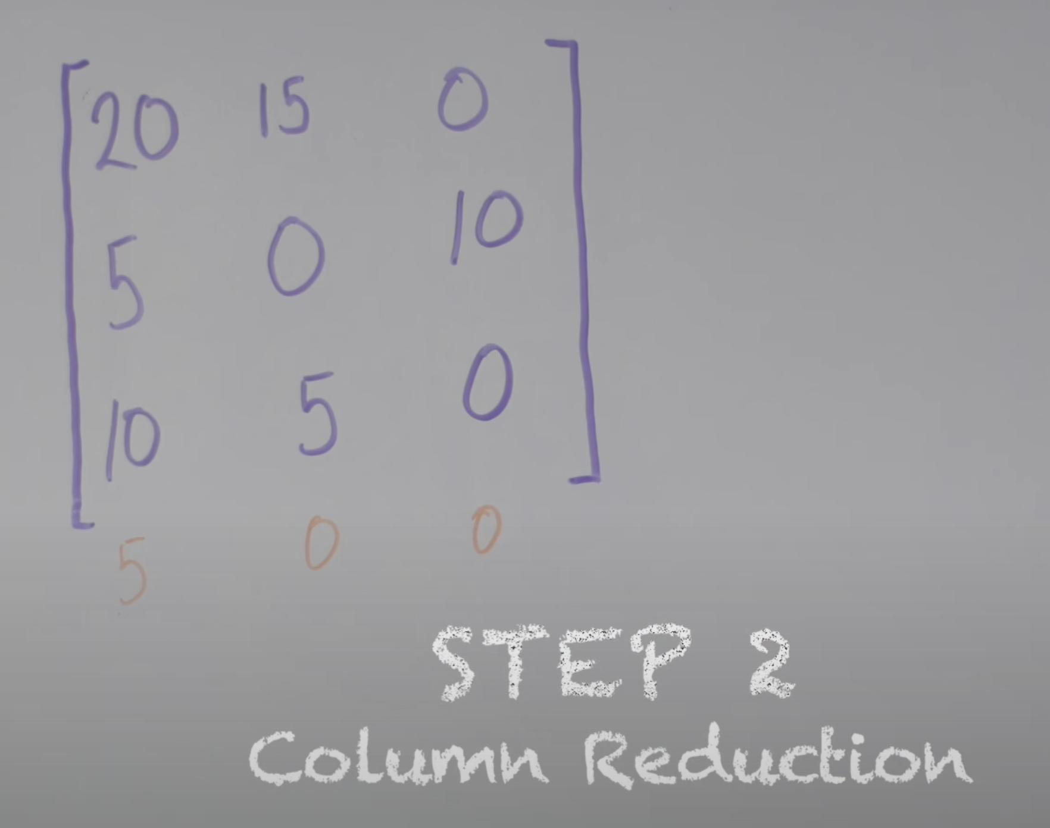
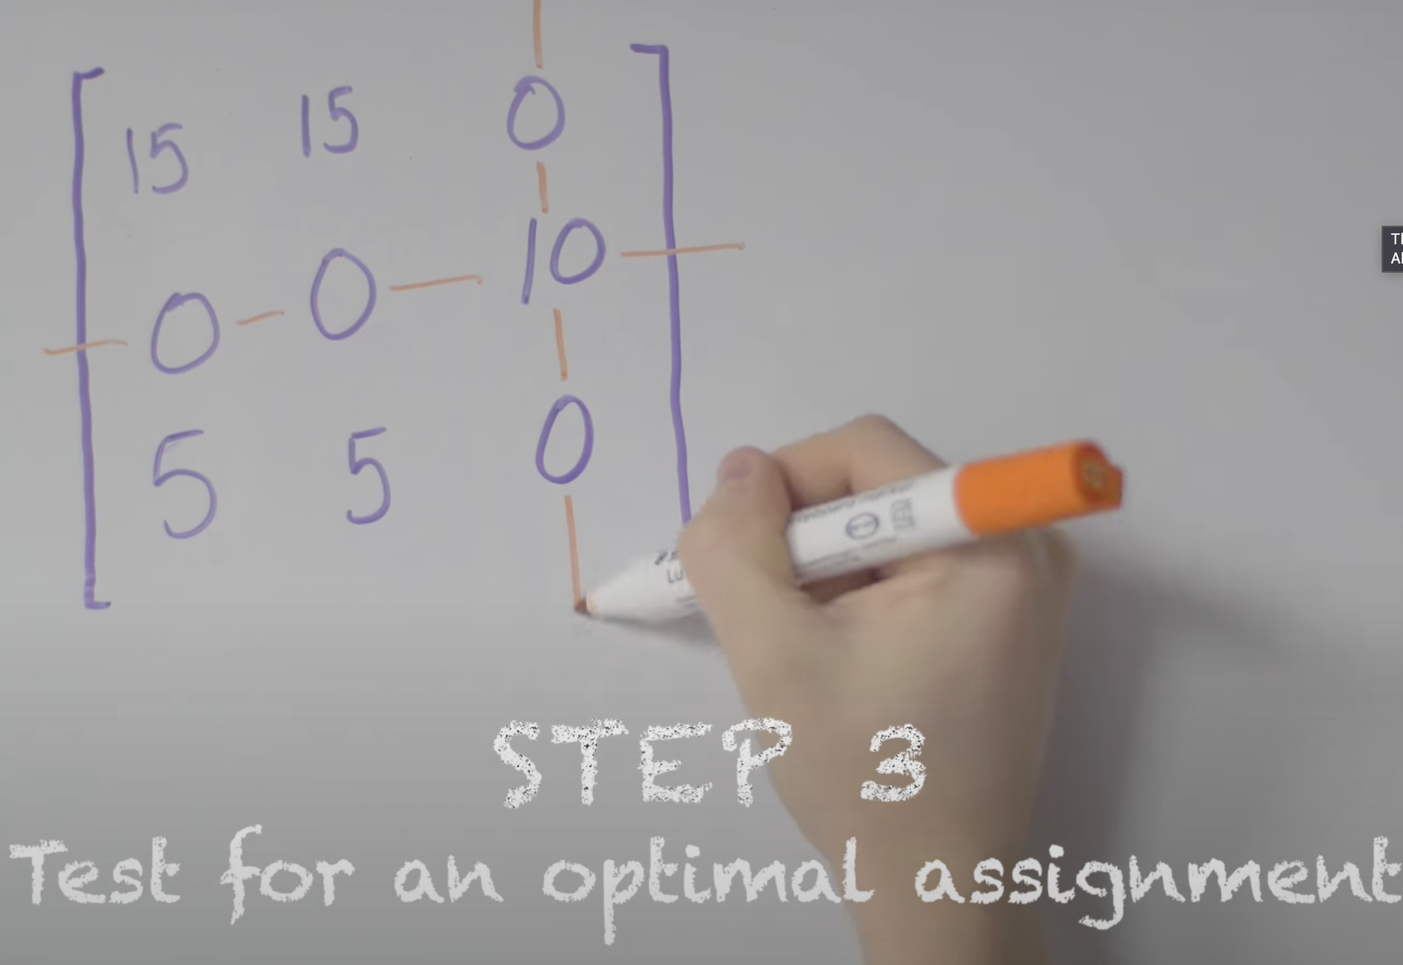
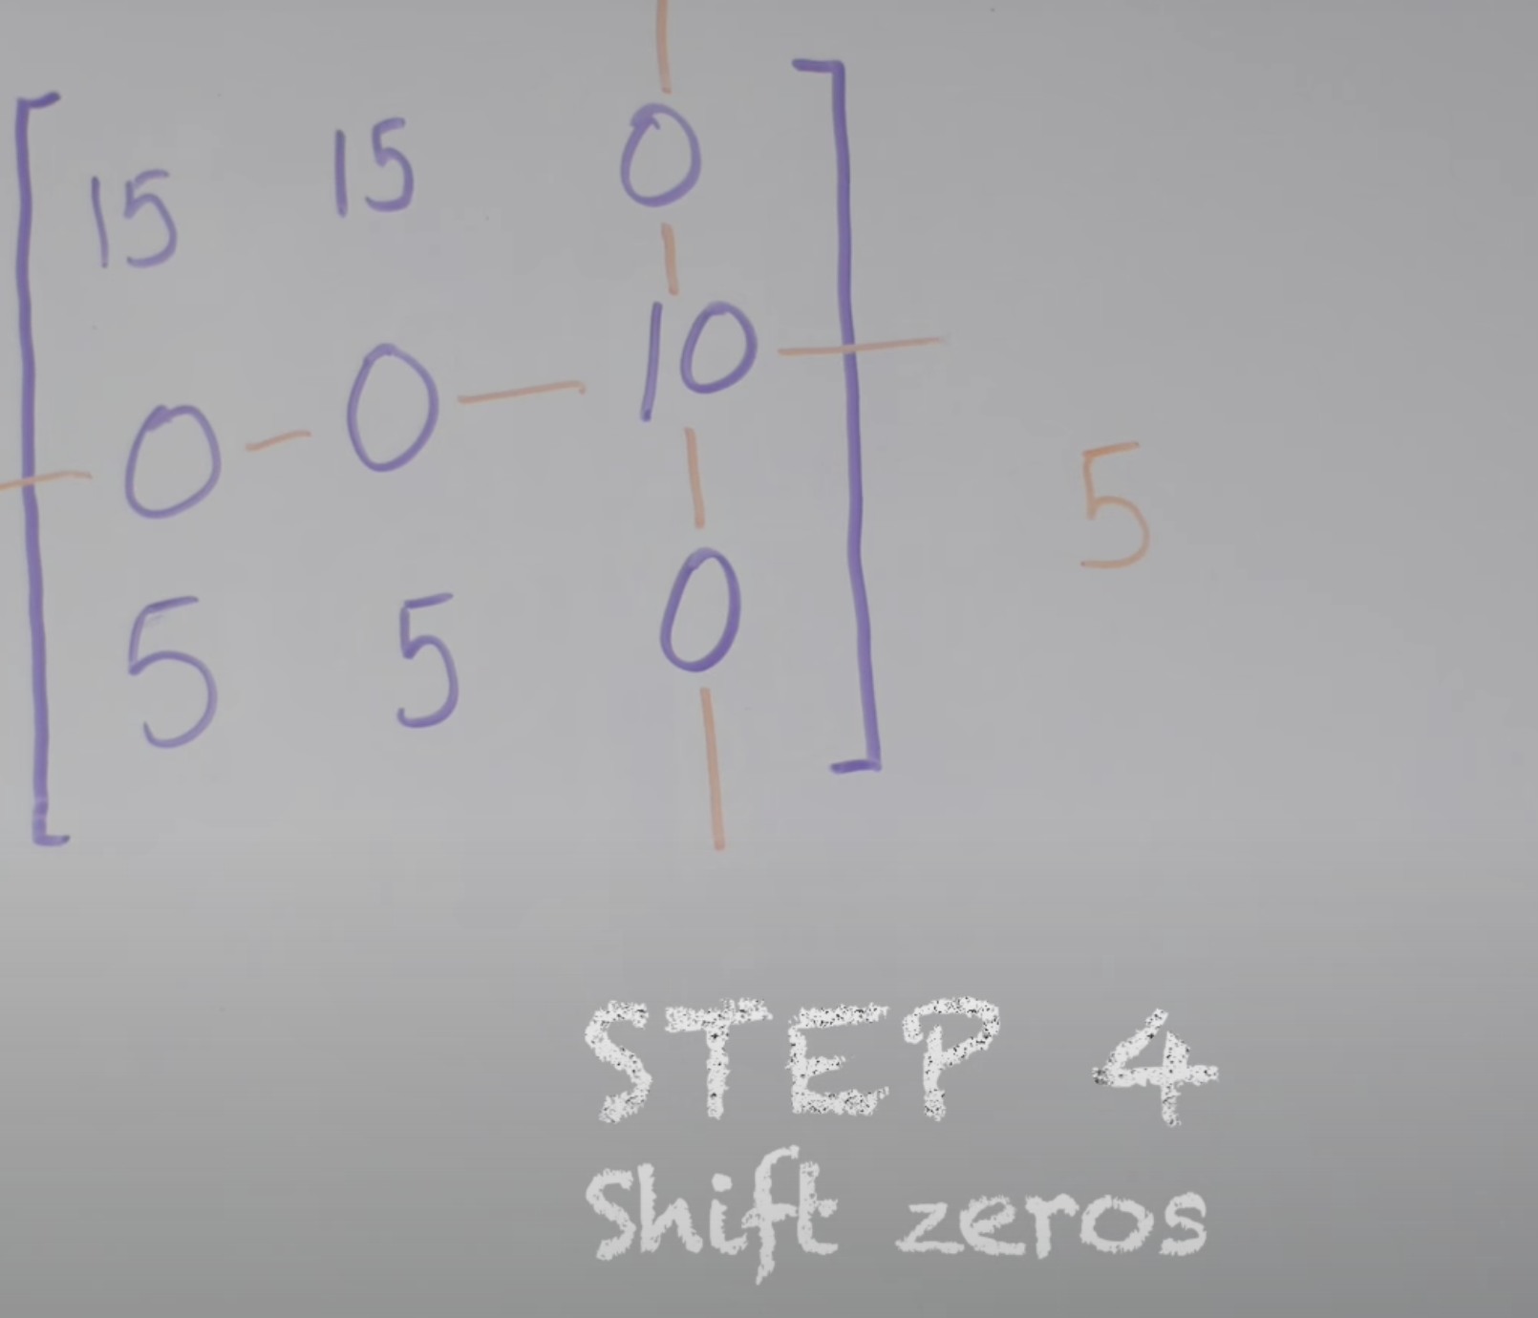
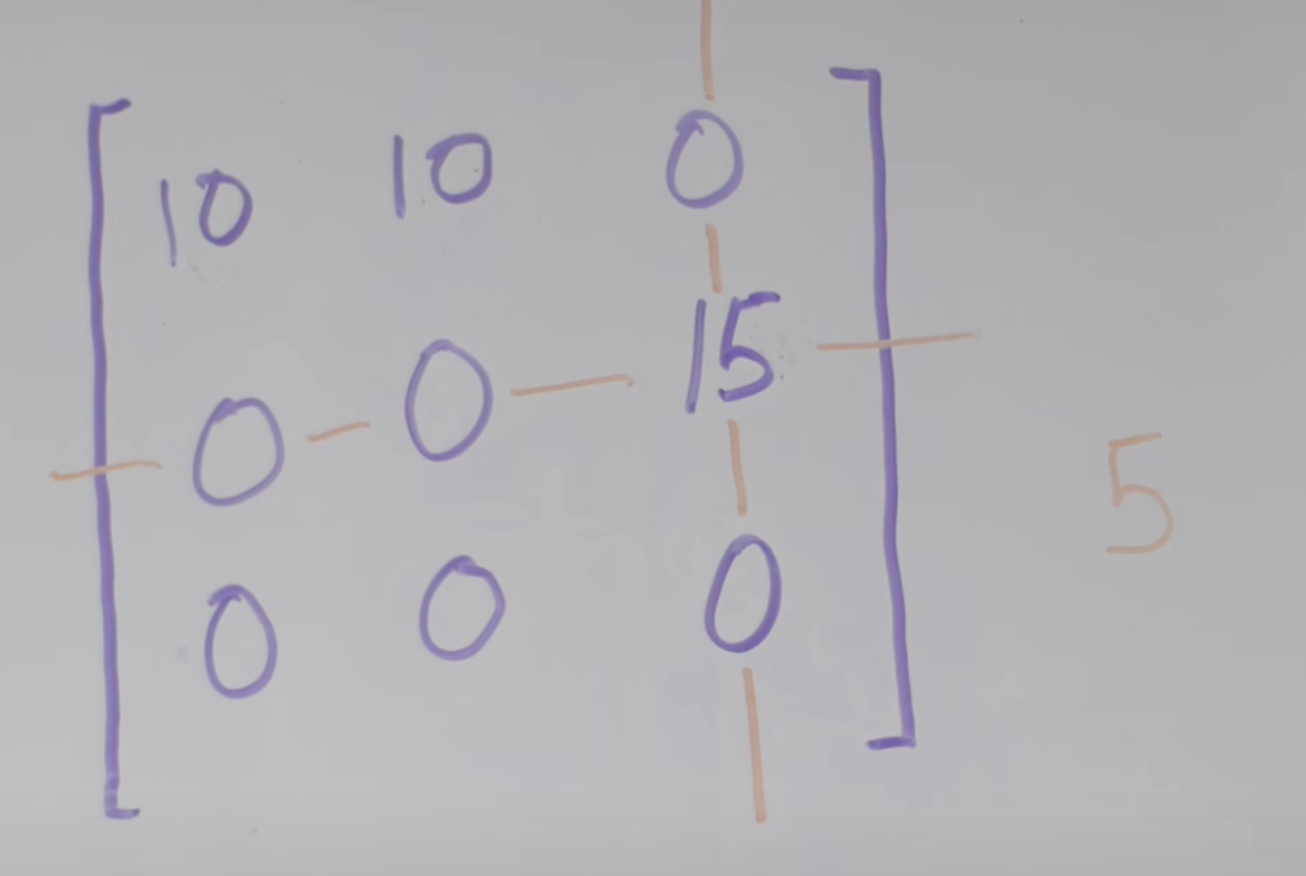
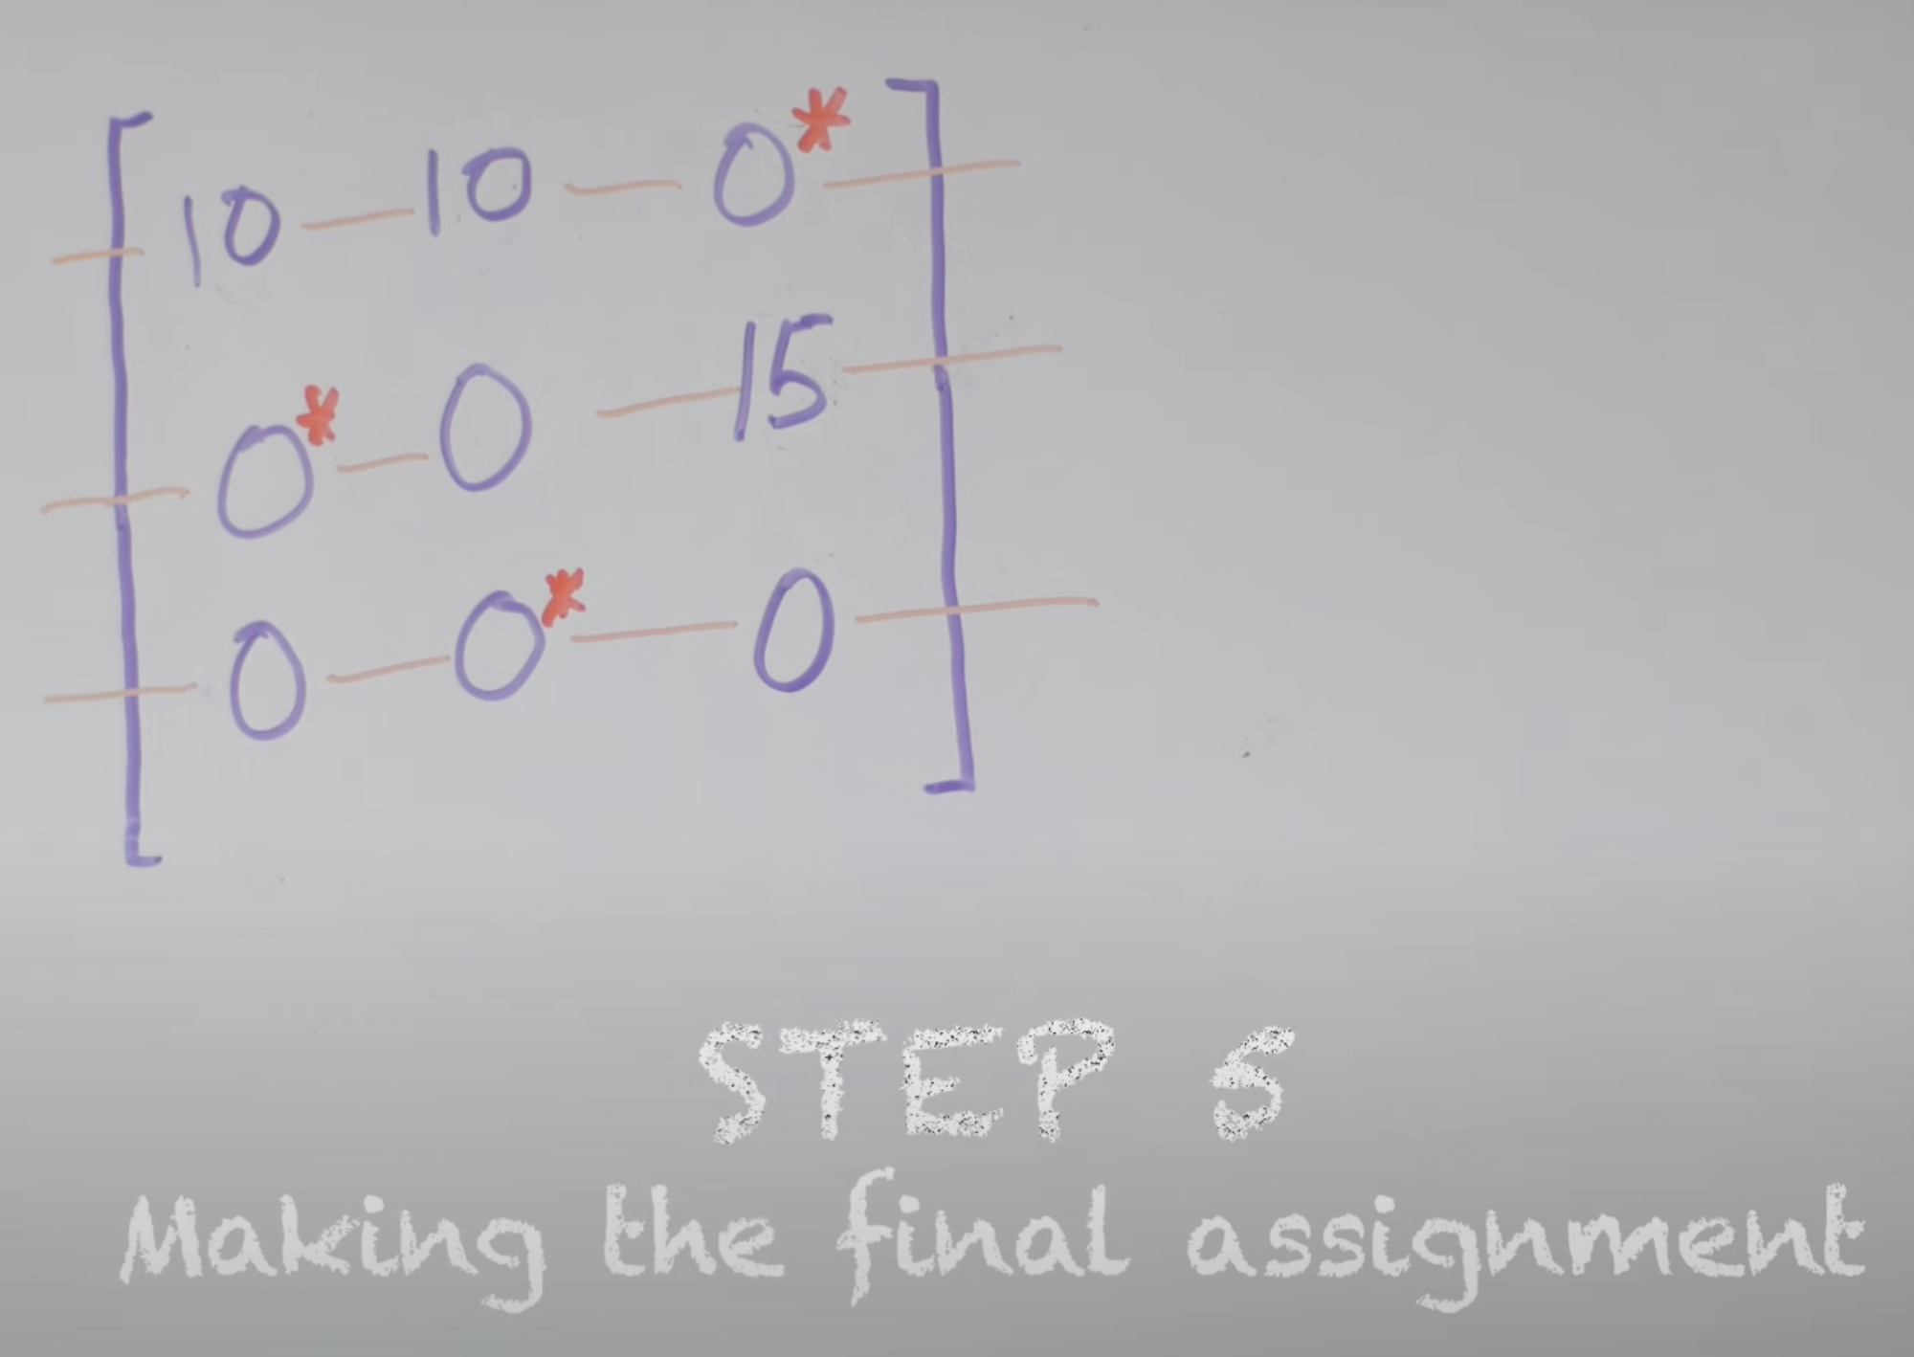
Hungarian Algorithm

Slide 10
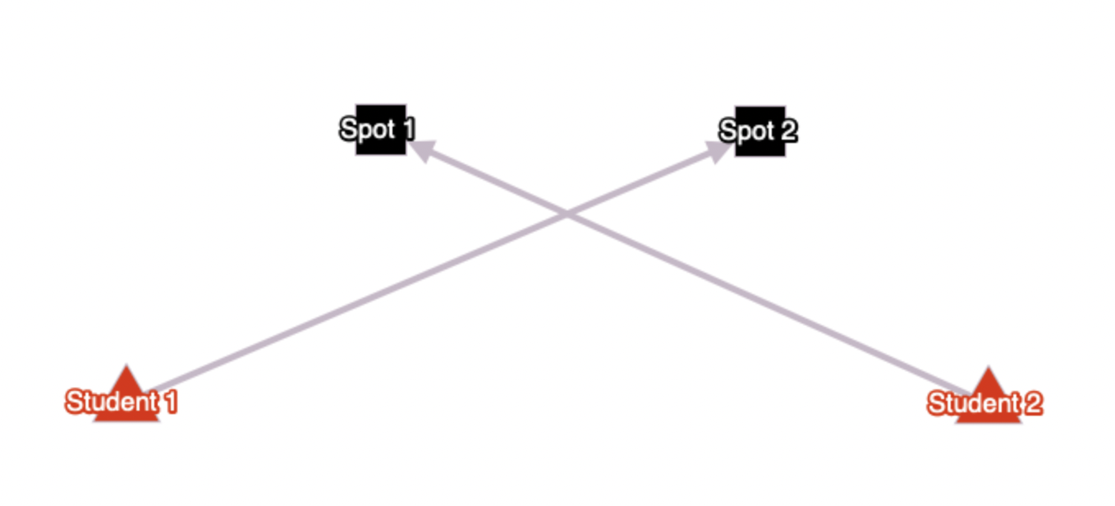
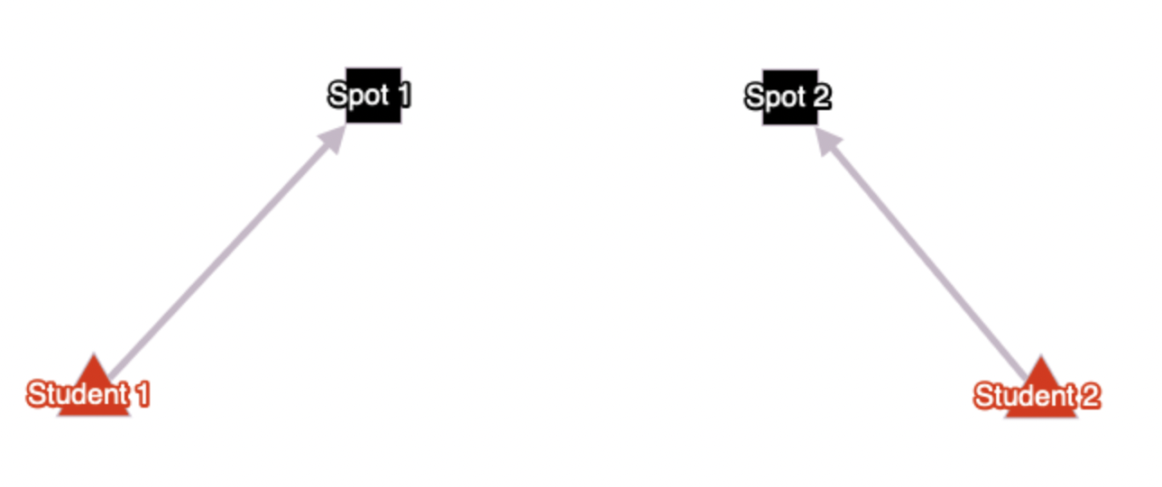
Local Search Algorithm

Slide 11
Experiment Design
Input:
980 parking spots on campus
900 randomly generated students with campus classes/dorms locations
Output:
An assignment of parking spots to students (one-to-one matching)
Notes:
Move assumptions slide to here

Slide 12
Assumptions
Assumption 1: Spots are distinguishable by white lines and unique spot IDs.
Assumption 2 (for now): Excess faculty and staff spots are part of the lottery system, meaning students can be assigned to them.
Assumption 3: Freshmen can have cars on campus

Slide 13
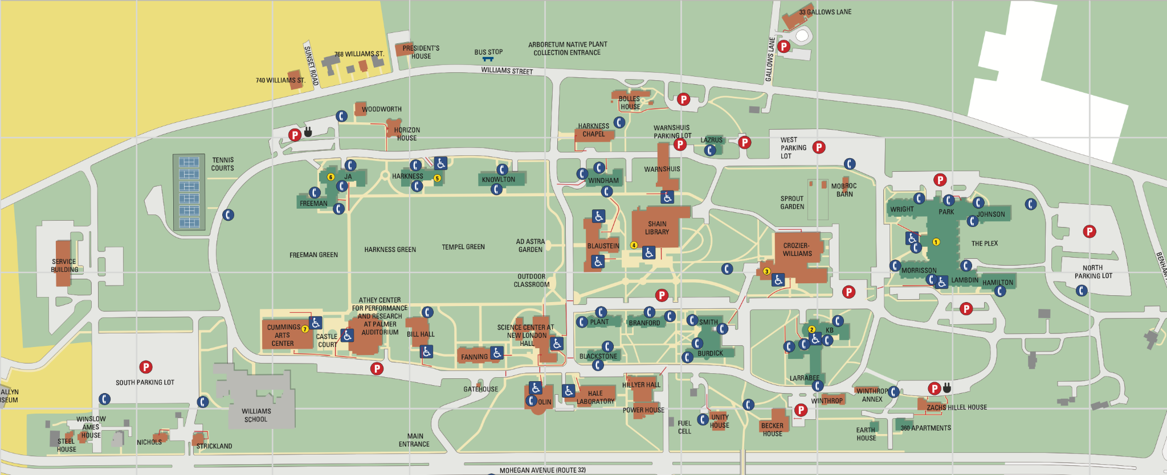
Campus Map

Slide 14

Parking Spots Generated on Campus Map
West Lot
South Lot
North Lot
Notes:
Add a slide before this one, (or as the background of the previous slide), of the campus map and explain the field work you did to collect data on parking spots, and how you then fed data into a program you wrote to visualize the parking spots to be used in the experiments

Slide 15
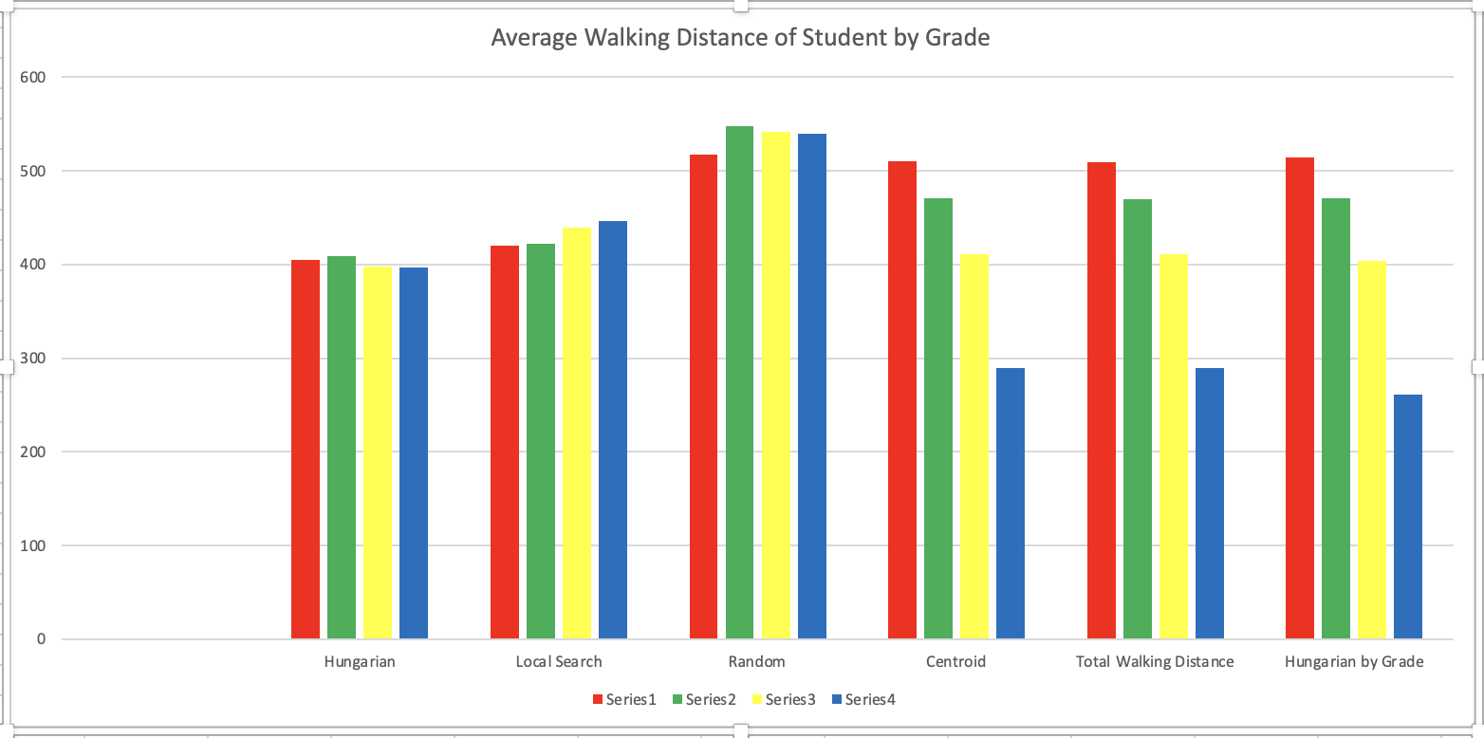
Average Walking Distance of Student by Grade
Freshmen: Red Sophomores: Green Juniors: Yellow Seniors: Blue
Notes:
Compile these into one image so they can compared next to each other easily visually

Slide 16
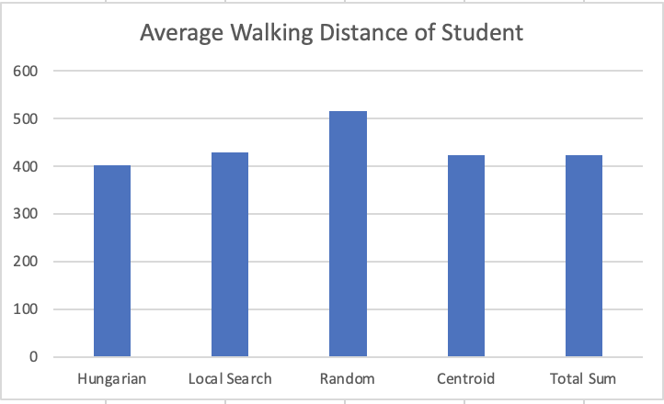
Average Walking Distance Results
Approach 3
Approach 1
Approach 2
Notes:
Indicate (by colors? Or bracket?) the three different approaches on these pictures

Slide 17
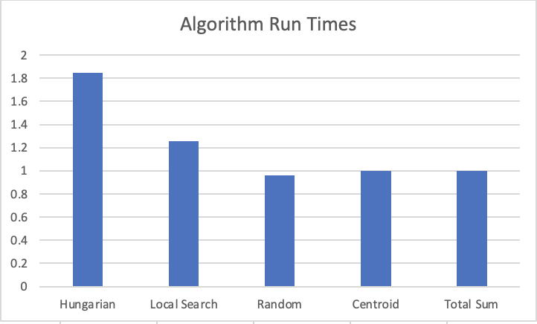
Run Time Comparison

Slide 18
Conclusion
All Methods:
Students are given more control over the parking system
Mitigates unregistered car issue
The lottery parking system pros:
Using a lottery system allows each student to choose their own spot
Still close to minimizing average walking distance of all students
Hungarian Alg pros:
Provides fairness to students and minimizes walking distance of students
Local Search pros:
Similar to Hungarian Alg but with faster run time (can get close to optimal solution)
Good for campuses with more students

Slide 19
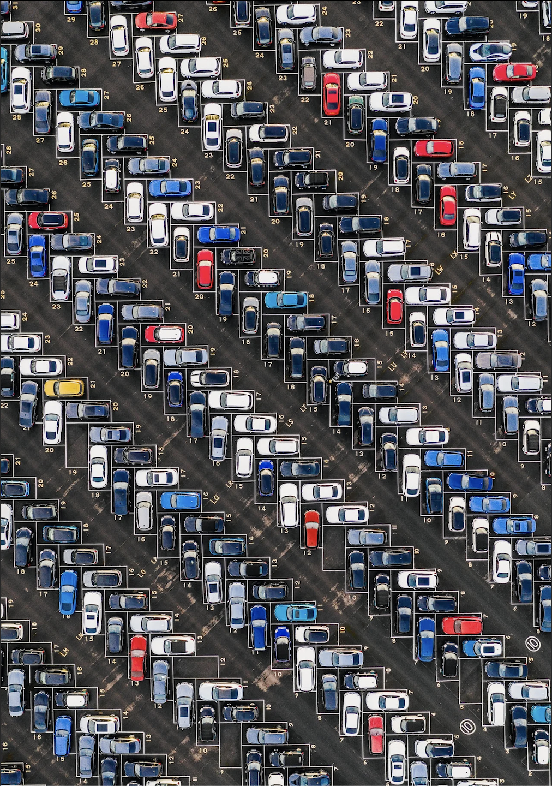
Questions?

Slide 20
References
O. Tran Thi Kim, N. H. Tran, C. Pham, T. LeAnh, M. T. Thai and C. S. Hong, "Parking Assignment: Minimizing Parking Expenses and Balancing Parking Demand Among Multiple Parking Lots," in IEEE Transactions on Automation Science and Engineering, vol. 17, no. 3, pp. 1320-1331, July 2020, doi: 10.1109/TASE.2019.2948200.
Sofiene Abidi, Saoussen Krichen, Enrique Alba, Juan Miguel Molina, “A New Heuristic for Solving the Parking Assignment Problem”, Procedia Computer Science, Volume 60, 2015, Pages 312-321, ISSN 1877-0509, https://doi.org/10.1016/j.procs.2015.08.132. (https://www.sciencedirect.com/science/article/pii/S1877050915022590)
Xinyuan Zhang, Cong Zhao, Feixiong Liao, Xinghua Li, Yuchuan Du, Online parking assignment in an environment of partially connected vehicles: A multi-agent deep reinforcement learning approach, Transportation Research Part C: Emerging Technologies, Volume 138, 2022, 103624, ISSN 0968-090X,
https://doi.org/10.1016/j.trc.2022.103624. (https://www.sciencedirect.com/science/article/pii/S0968090X22000699)
N. Mejri, M. Ayari, R. Langar, F. Kamoun, G. Pujolle and L. Saidane, "Cooperation versus competition towards an efficient parking assignment solution," 2014 IEEE International Conference on Communications (ICC), Sydney, NSW, Australia, 2014, pp. 2915-2920, doi: 10.1109/ICC.2014.6883767.
Hanae Errousso, Jihane El Ouadi, El Arbi Abdellaoui Alaoui, Siham Benhadou, Hicham Medromi,
A hybrid modeling approach for parking assignment in urban areas, Journal of King Saud University - Computer and Information Sciences, Volume 34, Issue 6, Part A, 2022, Pages 2405-2418, ISSN 1319-1578,
https://doi.org/10.1016/j.jksuci.2020.11.006. (https://www.sciencedirect.com/science/article/pii/S1319157820305310)

